Slide 1
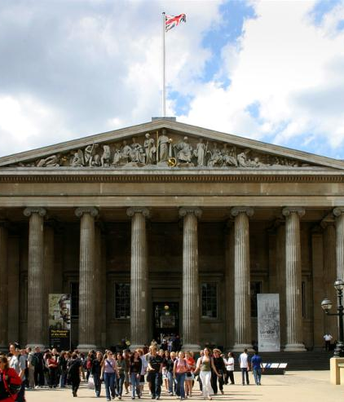
Introduction to the British Museum
Imagebank for ESOL tutors

Slide 2
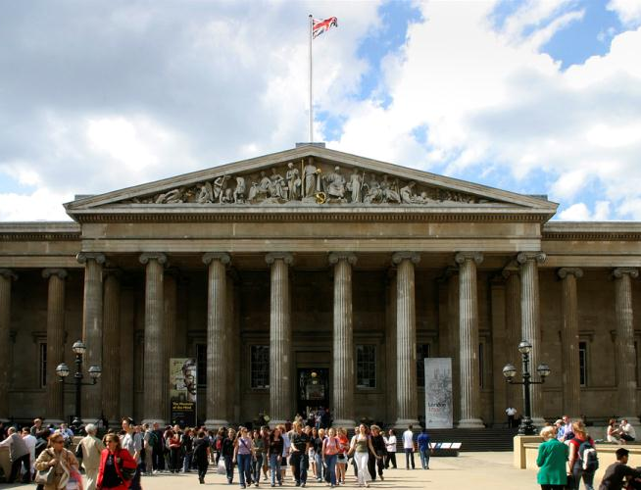
The Front Entrance of the British Museum
Notes:
Photo: The Front Entrance of the British Museum © Trustees of the British Museum
The Museum welcomes nearly 6 million visitors through its doors each year.

Slide 3
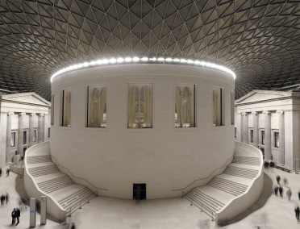
The Great Court at Night
Notes:
Image: Queen Elizabeth II Great Court © Trustees of the British Museum
Designed by Foster and Partners, the Queen Elizabeth II Great Court transformed the Museum’s inner courtyard into the largest covered public square in Europe. It is a two-acre space enclosed by a spectacular glass roof with the world-famous Reading Room at its centre.

Slide 4
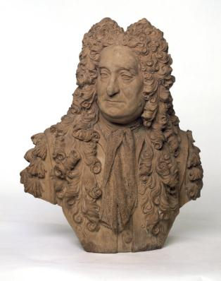
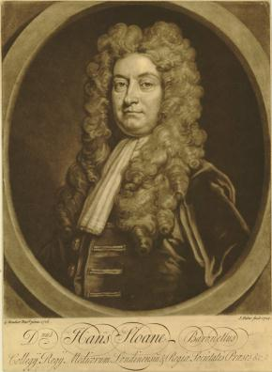
Sir Hans Sloane
Notes:
Object (left): Terracotta bust of Sir Hans Sloane (1660-1753) by Michael Rysbrack (1694-1770) on display in the Enlightenment Gallery (Room 1)
Object (right): Print of Sir Hans Sloane (1660-1753) by John Faber the Younger 1729 after an earlier portrait by Kneller from 1716.
© Trustees of the British Museum
Sir Hans Sloane (1660-1753): Physician and collector. His library and collections of antiquities, works of art and natural curiosities was bequeathed to the nation in return for the sum of £20,000 to be paid to his daughters, Sarah Stanley and Elizabeth Cadogan, and formed the chief foundation collection of the British Museum. Although money changed hands, the amount was at most one-quarter of the value of the collections and the transfer is referred to as the Sloane Bequest.
Born in Ireland; trained as a physician in London and France; 1687-89, to Jamaica as personal physician to the governor, Christopher Monck, Duke of Albemarle.1693 set up what was to become a highly successful medical practice in Bloomsbury; 1695, married Elizabeth Rose (d.1724), widow of a Jamaican planter who brought with her a substantial income from her late husband's estates; also made a considerable amount of money from promoting milk chocolate. 1695, elected secretary of the Royal Society which he was responsible for revitalising; 1727, succeeded Newton as President, retiring in 1741. 1696, published his catalogue of Jamaican plants, and in 1707 and 1725 the two volumes of his "Voyage to the islands Madera, Barbados, Nieves, S. Christophers, and Jamaica, with the natural history ... of the last of those islands" . 1712, appointed physician to Queen Anne (subsequently also to George I and George II); 1716, created baronet. 1719, President of the Royal College of Physicians. 1722, as landlord of the manor of Chelsea, conveyed the Physick Garden to the Society of Apothecaries in return for an annual payment of £5. 1742 retired to Chelsea where he died on 11 January 1753.

Slide 5
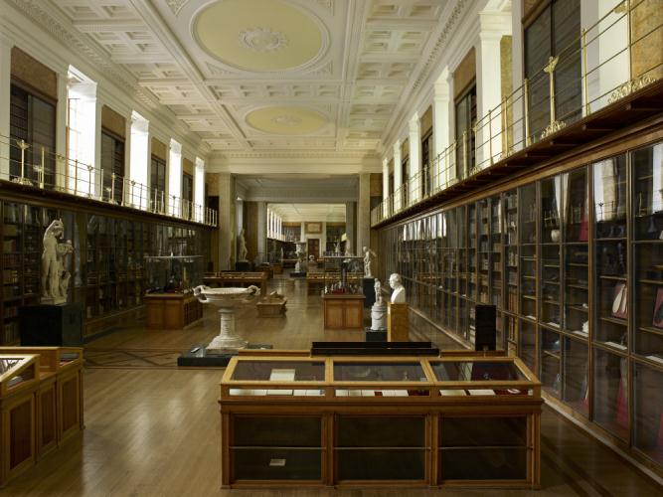
The Enlightenment Gallery
(Room 1)
Notes:
The Kings Library / Enlightenment Gallery
Image: The Enlightenment Gallery © Trustees of the British Museum
Formerly known as the King’s Library, this room was built between 1823 and 1827 and was the first part of the new Museum building as it is seen today.
The King's Library was a royal collection of books created by King George III and donated to the nation. A gallery, named after the collection, was built at the British Museum in 1827 to house them. It is the oldest room in the Museum and now home to the permanent exhibition Enlightenment: Discovering the world in the eighteenth century.
Careful restoration work between 2000 and 2003 revived the original room to its previous glory, in time to celebrate the Museum’s 250th anniversary. Cleaning and repairs to the oak and mahogany floor and classical architectural features have refreshed the space. Hundreds of square metres of plaster were cleaned and repaired to restore the yellow and gold ornamentation and the re-gilded balcony.

Slide 6
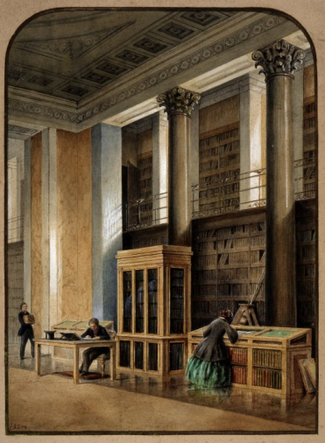
The Kings Library c.1851
Notes:
Image: The Tribune of the King's Library; view of the interior of the King's Library; a reader studying at a table, l, with an assistant approaching carrying a pile of books; a woman in a crinoline inspecting items in the top of a table case, r. c.1851 Watercolour and bodycolour © Trustees of the British Musuem
The Kings Library / Enlightenment Gallery
Formerly known as the King’s Library, this room was built between 1823 and 1827 and was the first part of the new Museum building as it is seen today.
The King's Library was a royal collection of books created by King George III and donated to the nation. A gallery, named after the collection, was built at the British Museum in 1827 to house them. It is the oldest room in the Museum and now home to the permanent exhibition Enlightenment: Discovering the world in the eighteenth century.
Careful restoration work between 2000 and 2003 revived the original room to its previous glory, in time to celebrate the Museum’s 250th anniversary. Cleaning and repairs to the oak and mahogany floor and classical architectural features have refreshed the space. Hundreds of square metres of plaster were cleaned and repaired to restore the yellow and gold ornamentation and the re-gilded balcony.

Slide 7
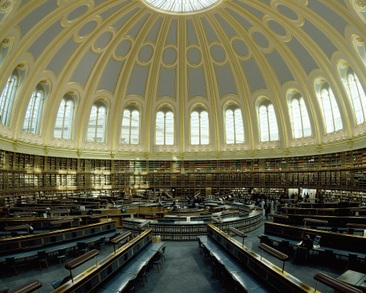
The Reading Room
Notes:
Image: The Reading Room in 2006 © Trustees of the British Museum
The Reading Room
The Reading Room stands at the heart of the Museum, in the centre of the Great Court. Completed in 1857, it was hailed as one of the great sights of London and became a world famous centre of learning. It was restored in 2000 and is currently used to host major exhibitions. The Reading Room stands at the heart of the Museum, in the centre of the Great Court. Completed in 1857, it was hailed as one of the great sights of London and became a world famous centre of learning. It was restored in 2000 and is currently used to host major exhibitions.

Slide 8
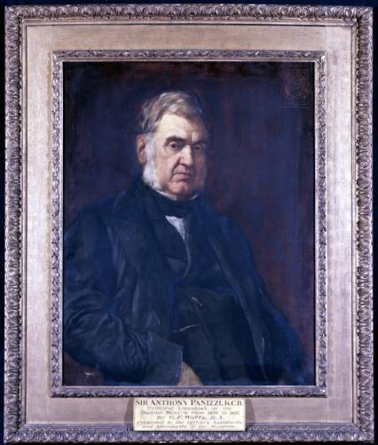
Sir Antonio Panizzi
Notes:
Object: Portrait of Antonio Panizzi, later Sir Anthony Panizzi (1787-1879), Principal Librarian of the British Museum by George Frederick Watt © Trustees of the British Museum
Antonio Panizzi (later Sir Anthony Panizzi) arrived in England as a refugee from Italy in 1823. Through talent and good connections he was appointed to the Museum in 1831, becoming Keeper of Printed Books in 1837 and Principal Librarian in 1856. An outstanding librarian, he immensely improved the Museum’s holdings and cataloguing methods and was the driving force behind the construction of the Round Reading Room which opened in 1857. (A plan of the room as used on invitations to the opening can be seen in the top right corner of the painting.) A forceful individual, he inspired both hatred and devotion. He did improve working conditions for the staff and the portrait was thus commissioned to mark his retirement in 1866 It was one of a number of portraits not transferred to the National Portrait Gallery in 1879 but, by agreement, retained by the British Museum because of its considerable historical importance for that institution.

Slide 9
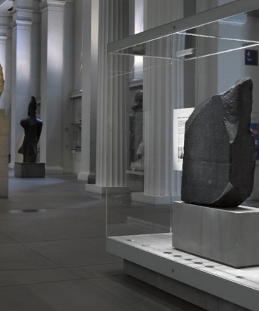
10 highlight objects from the collection
The Rosetta Stone
Assyrian Lion Hunt reliefs
Parthenon sculptures
Lewis Chessmen
Oxus Treasure
Royal Game of Ur
Mummy of Katebet
Samurai armour
King of Ife
The Rosetta Stone in Room 4
Notes:
Photo: The Rosetta Stone is on display in Room 4, The Egyptian Sculpture Gallery © Trustees of the British Museum
If you are short of time, this is a recommend list of objects to visit for an insight into the variety of the Museum's collection.
The Rosetta Stone (Ground floor)
Assyrian Lion Hunt reliefs (Ground floor)
Parthenon sculptures (Ground floor)
Lewis Chessmen (Upper floor)
Oxus Treasure (Upper floor)
Royal Game of Ur (Upper floor)
Mummy of Katebet (Upper floor)
Samurai armour (Upper floor)
King of Ife (Lower floor)

Slide 10
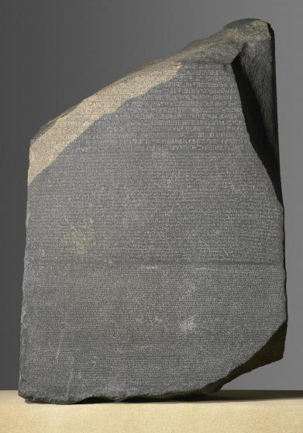
The Rosetta Stone
Notes:
Object: The Rosetta Stone, from Fort St Julien, el-Rashid (Rosetta), Egypt, Ptolemaic Period, 196 BC © Trustees of the British Museum
The inscription on the Rosetta Stone is a decree passed by a council of priests, one of a series that affirm the royal cult of the 13-year-old Ptolemy V on the first anniversary of his coronation.
In previous years the family of the Ptolemies had lost control of certain parts of the country. It had taken their armies some time to put down opposition in the Delta, and parts of southern Upper Egypt, particularly Thebes, were not yet back under the government's control.
Before the Ptolemaic era (that is before about 332 BC), decrees in hieroglyphs such as this were usually set up by the king. It shows how much things had changed from Pharaonic times that the priests, the only people who had kept the knowledge of writing hieroglyphs, were now issuing such decrees. The list of good deeds done by the king for the temples hints at the way in which the support of the priests was ensured.
The decree is inscribed on the stone three times, in hieroglyphic (suitable for a priestly decree), demotic (the native script used for daily purposes), and Greek (the language of the administration). The importance of this to Egyptology is immense. Soon after the end of the fourth century AD, when hieroglyphs had gone out of use, the knowledge of how to read and write them disappeared. In the early years of the nineteenth century, some 1400 years later, scholars were able to use the Greek inscription on this stone as the key to decipher them. Thomas Young, an English physicist, was the first to show that some of the hieroglyphs on the Rosetta Stone wrote the sounds of a royal name, that of Ptolemy. The French scholar Jean-François Champollion then realized that hieroglyphs recorded the sound of the Egyptian language and laid the foundations of our knowledge of ancient Egyptian language and culture.
Soldiers in Napoleon's army discovered the Rosetta Stone in 1799 while digging the foundations of an addition to a fort near the town of el-Rashid (Rosetta). On Napoleon's defeat, the stone became the property of the English under the terms of the Treaty of Alexandria (1801) along with other antiquities that the French had found.
The Rosetta Stone has been exhibited in the British Museum since 1802, with only one break. Towards the end of the First World War, in 1917, when the Museum was concerned about heavy bombing in London, they moved it to safety along with other, portable, 'important' objects. The Rosetta Stone spent the next two years in a station on the Postal Tube Railway fifty feet below the ground at Holborn.

Slide 11
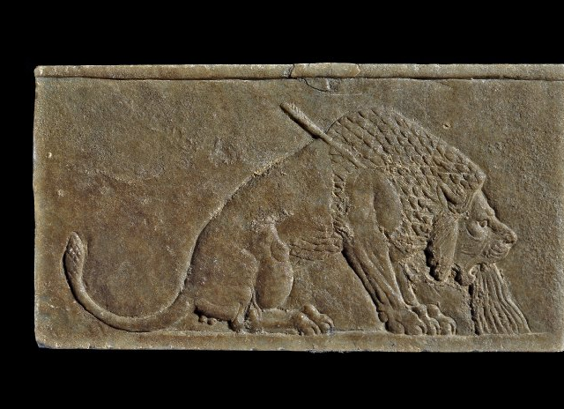
The Dying Lion, a stone panel from the North Palace of Ashurbanipa
Notes:
Object: The Dying Lion, a stone panel from the North Palace of Ashurbanipal © Trustees of the British Museum
The Dying Lion, a stone panel from the North Palace of Ashurbanipal
Nineveh, northern Iraq
Neo-Assyrian, around 645 BC
The triumph of the Assyrian king over nature
This small alabaster panel was part of a series of wall panels that showed a royal hunt. It has long been acclaimed as a masterpiece; the skill of the Assyrian artist in the observation and realistic portrayal of the animal is clear.
Struck by one of the king's arrows, blood gushes from the lion's mouth. Veins stand out on its face. From a modern viewpoint, it is tempting to think that the artist sympathized with the dying animal. However, lions were regarded as symbolizing everything that was hostile to urban civilization and it is more probable that the viewer was meant to laugh, not cry.
There was a very long tradition of royal lion hunts in Mesopotamia, with similar scenes known from the late fourth millennium BC. The connection between kingship and lions was probably brought to western Europe as a result of the crusades in the twelfth and thirteenth centuries AD, when lions begin to decorate royal coats of arms.

Slide 12
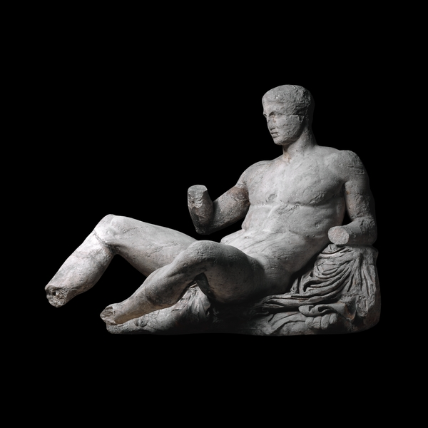
Figure of Dionysos
Notes:
Object: Figure of Dionysos from the east pediment of the Parthenon © Trustees of the British Museum
Figure of Dionysos from the east pediment of the Parthenon
The Acropolis, Athens, Greece, about 438-432 BC
The central section of the east pediment of the Parthenon showed the birth of Athena. The myth was not often depicted in classical times, although it had been popular in the Archaic period, especially on vases. This reclining figure almost certainly represents Dionysos, god of wine. He looked out from the pediment towards the corner and the chariot of Helios, god of the sun, rising at daybreak.
Pediments are the triangular spaces formed by the pitch of the roof of a Greek temple, one at either end of the building. They were often filled with sculpture representing mythological subjects. The triangular frame of the pediment presented a challenge to the designers of the sculpture placed within. There was a danger that figures at the centre would appear as giants compared with those that occupied the corners. This discrepancy in scale was lessened by allowing figures towards the corners to sit, and right in the corners, to recline. This reclining male nude is well adapted to his position.
The Parthenon was built as a temple dedicated to the goddess Athena. It was the centrepiece of an ambitious building programme on the Acropolis of Athens.
The temple’s great size and lavish use of white marble was intended to show off the city’s power and wealth at the height of its empire. Room 18 exhibits sculptures that once decorated the outside of the building.
The pediments and metopes illustrate episodes from Greek mythology, while the frieze represents the people of contemporary Athens in religious procession.
Rooms 18a and 18b feature fragments of the Parthenon sculpture and also pieces of architecture. Video displays using computer graphics explain how the sculptures were placed on the building, and a touch tour for visually impaired visitors includes a model, some original architecture and plaster casts of the frieze.

Slide 13
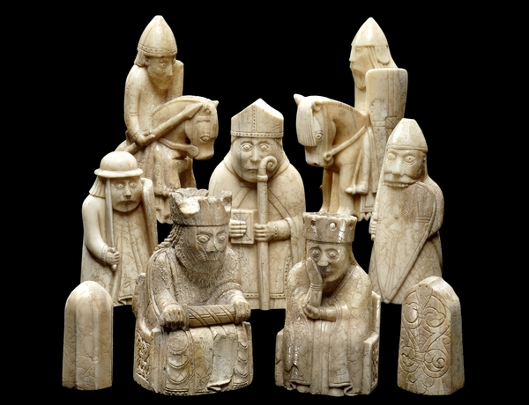
Lewis Chessmen
Notes:
Object: The Lewis Chessmen © The British Museum
One of the most interesting objects from Britain found in the British Museum are the Lewis Chessmen.
The chess pieces consist of elaborately worked walrus ivory and whales' teeth in the forms of seated kings and queens, mitred bishops, knights on their mounts, standing warders and pawns in the shape of obelisks.
They were found in the vicinity of Uig on the Isle of Lewis in mysterious circumstances. Various stories have evolved to explain why they were concealed there, and how they were discovered. All that is certain is that they were found some time before 11 April 1831, when they were exhibited in Edinburgh at the Society of Antiquaries for Scotland. The precise findspot seems to have been a sand dune where they may have been placed in a small, drystone chamber.
Who owned the chess pieces? Why were they hidden? While there are no firm answers to these questions, it is possible that they belonged to a merchant travelling from Norway to Ireland. This seems likely since there are constituent pieces - though with some elements missing - for four distinct sets. Their general condition is excellent and they do not seem to have been used much, if at all.
By the end of the eleventh century, chess was a very popular game among the aristocracy throughout Europe. The Lewis chess pieces form the largest single surviving group of objects from the period that were made purely for recreational purposes. The question of precisely where they were made is a difficult one to resolve.
When Sir Frederic Madden first published the finds in 1832, he considered them to be Icelandic in origin. This argument has been repeated recently by Icelandic commentators on the subject. Other authorities have thought them to be Irish, Scottish or English. Each of these attributions is possible.
What is known with certainty is that the chessmen are vigorously northern in their character and are strongly influenced by Norse culture. This is most evident in the figures of the warders or rooks which take the
form of Berserkers, fierce mythical warriors drawn directly from the Sagas. The historic political, economic and cultural links between the Outer Hebrides and Norway and its dominance of the Norse world might suggest that Norway is the most likely place to have produced these high status, luxury commodities.
A board large enough to hold all the pieces arranged for a game played to modern rules would have measured 82 cm across. Records state that when found, some of the Lewis chessmen were stained red.
Consequently the chessboard may have been red and white, as opposed to the modern convention of black and white.
Of the 93 pieces known to us today, 11 pieces are in Edinburgh at the National Museum of Scotland, and 82 are in the British Museum.

Slide 14
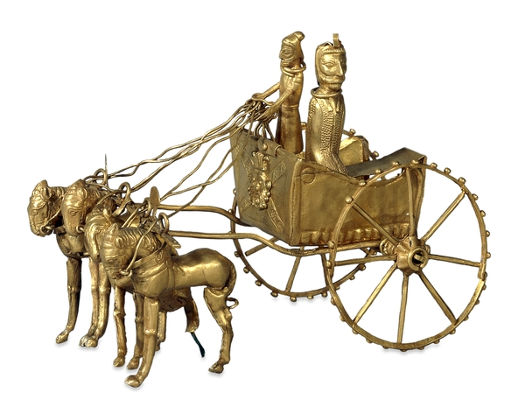
The Oxus Treasure
Notes:
Object: Oxus chariot model from the Oxus Treasure © Trustees of the British Museum
Oxus chariot mode
Region of Takht-i Kuwad, Tadjikistan, Achaemenid Persian, 5th-4th century BC
This remarkable model is one of the most outstanding pieces in the Oxus treasure, which dates mainly from the fifth and fourth centuries BC.
The Oxus Treasure is the most important surviving collection of gold and silver to have survived from the Achaemenid period.
The model chariot is pulled by four horses or ponies. In it are two figures wearing Median dress. The Medes were from Iran, the centre of the Achaemenid empire. The front of the chariot is decorated with the Egyptian dwarf-god Bes, a popular protective deity. The chariot can be compared with that shown being ridden by the Persian king Darius on a cylinder seal also in the British Museum.
A second fragmentary gold chariot now in the British Museum was acquired by the Earl of Lytton, the Viceroy of India, about the same time that the Oxus treasure was discovered and is thought to have come from the same source.

Slide 15
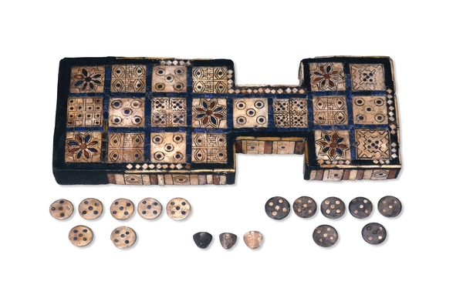
The Royal Game of Ur
Notes:
Object: The Royal Game of Ur © Trustees of the British Museum
The Royal Game of Ur
From Ur, southern Iraq, about 2600-2400 BC
One of the most popular games of the ancient world
This game board is one of several with a similar layout found by Leonard Woolley in the Royal Cemetery at Ur. The wood had decayed but the inlay of shell, red limestone and lapis lazuli survived in position so that the original shape could be restored. The board has twenty squares made of shell: Five squares each have flower rosettes, 'eyes', and circled dots. The remaining five squares have various designs of five dots. According to references in ancient documents, two players competed to race their pieces from one end of the board to another. Pieces were allowed on to the board at the beginning only with specific throws of the dice. We also know that rosette spaces were lucky.
The gaming pieces for this particular board do not survive. However, some sets of gaming pieces of inlaid shale and shell were excavated at Ur with their boards. The boards appear to have been hollow with the pieces stored inside. Dice, either stick dice or tetrahedral in shape, were also found.
Examples of this 'Game of Twenty Squares' date from about 3000 BC to the first millennium AD and are found widely from the eastern Mediterranean and Egypt to India. A version of the Mesopotamian game survived within the Jewish community at Cochin, South India until modern times.
You can play the Royal Game of Ur on-line at The British Museum's Mesopotamia website (requires Shockwave).

Slide 16
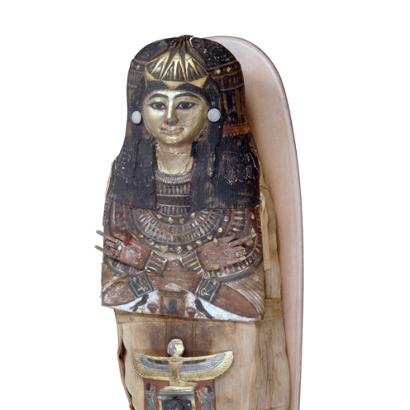
Mummy of Katebet
Notes:
Object: Mummy of Katebet,
Mummy of Katebet
From Thebes, Egypt
Late 18th or early 19th Dynasty, around 1300-1280 BC
This mummy is that of an old woman who was a Chantress of Amun, the ‘King of the Gods’. As a holder of this title, she would have sung and performed music during the rituals that were performed in the temples.
She was called Katebet and her preserved body is wrapped within layers of cloth. The painted cartonnage mummy-mask covering her head has a gilded face and shows her wearing an elaborate wig and white earrings. Her crossed hands wear real rings.
On Katebet’s stomach there is a small dark scarab beetle, which would offer her magical protection when she was judged by the gods. Further down her body – about where her knees must be – is a small statue in the form of a mummy, a shabti. It was there to carry out any hard manual tasks which the owner would be required to perform in the afterlife.
After death, the body of a person of high rank would have been washed and the internal organs removed. After the body had been dried, using natron salt, the area where the organs had been would be packed with wood shavings. Next the skin was coated in resin, and then the body was wrapped in strips of linen. It was placed in a coffin, ready for its long journey to the afterlife.
British Museum scientists have used a CAT scanner to find out more about Katebet without damaging her. This has revealed that she was elderly when she died, with only two remaining teeth. Her brain was not removed, even though this was usual in mummification.
Both the coffin and the equipment of the mummy are of unusual types. The shape of the wig and position of the hands on the coffin show that it was originally designed for a man, and then altered to be used for Katebet. Some of the objects placed on the mummy were also prepared for a man. It is known that Katebet was buried with a man named Qenna, who may have been her husband. His mummy has not survived, and it is possible that some of the objects now placed on Katebet’s wrappings really came from his coffin.

Slide 17
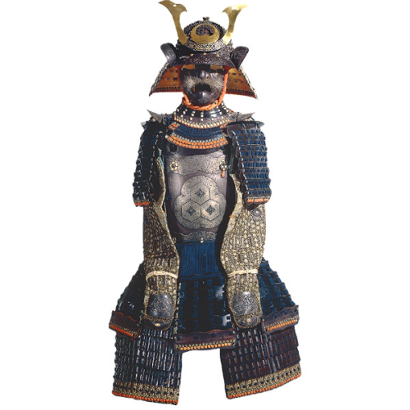
Samurai Armout
Notes:
Object: Samurai armour © Trustees of the British Museum
Set of armour
From Japan
Momoyama period, late 16th century (cuirass and sleeves; Edo period, 17th century (helmet), 18th-19th century (remainder)
This composite suit of Japanese armour brings together items from different periods.
The helmet, though made in the seventeenth century, is in the tradition of earlier pieces which were often given a hideous face-mask with bristling whiskers to strike terror into the enemy.
With the arrival of firearms in the sixteenth century new bullet-proof cuirasses were developed in Japan, copied from European models. The example here is signed by Unkai Mitsunao. This and the silk sleeves covered with chain-mail and iron plates were made in the late sixteenth century. The neck-piece, shoulder flaps, divided skirt and leg pieces are made of lacquered iron platelets held together with cords and colourful silk braids. They were made in the eighteenth and nineteenth century.
In the Edo period (1600-1868) armour was generally more ceremonial, and made of lighter metals. However, some provincial lords, especially the Date clan of Sendai, kept up the appearance of being always prepared for battle, possibly in memory of their ancestors' defeat by the Tokugawa clan under Ieyasu in the decisive battle of Seki ga Hara (AD 1600).

Slide 18
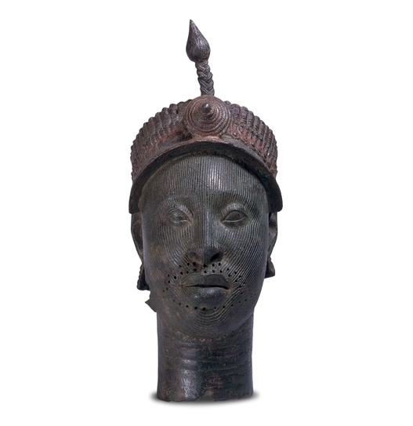
Notes:
This head is one of the most famous objects in the British Museum's ethnographic collections.
Object: Ife head © Trustees of the British Museum
Brass head of a ruler
Wunmonije Compound, Ife, Nigeria, probably 1300s – early 1400s
In January 1938 workmen were digging foundations for a new house in Wunmonije Compound in the city of Ife, in what is now south-western Nigeria. While clearing away the topsoil they struck metal and further digging revealed a group of cast heads.
This accidental find led to the eventual discovery of 17 heads in brass and copper and the broken top half of a king figure.
This magnificent head was one of those discovered in Wunmonije Compound. It was purchased in Ife by Mr Bates, then editor of the Nigerian Daily Times and was subsequently acquired by Sir (later Lord) Kenneth Clark, Director of the National Gallery, acting on behalf of the National Art Collections Fund for the British Museum.
This head clearly portrays a person of status and authority. The elaborate headdress probably represents a crown. It has a central band which appears to include numerous glass or stone beads of different shapes and sizes. A fringe of feathers is indicated along the crown’s peaked front. The back of the neck is hidden by a beaded and plaited cover.
Most striking perhaps is the plaited crest rising from the front of the crown with a beaded conical boss at its base. Traces of red and black paint are evident throughout.
The finds from Wunmonije Compound were published in 1938-9 and created a sensation in the western world. It was initially assumed that these beautiful sculptures could not have been made in Africa by African artists. The naturalism of the works gave them a portrait-like appearance and comparisons were immediately made with masterpieces from European traditions.
The sculptures from Ife are now rightly seen as one of the highest achievements of African art and culture.

Slide 19
www.britishmuseum.org

